Slide 1

Shodan and Maltego
A quick introduction

Slide 2

What is Shodan?
Shodan is a search engine that lets the user find specific types of computers (webcams, routers, servers, etc.) connected to the internet using a variety of filters. (Courtesy of Wikipedia)
Notes:
Don’t forget IoT, Google for intelligence gathering
Real time 24/7 from all over the world to bypass country blocks (not incremental)

Slide 3
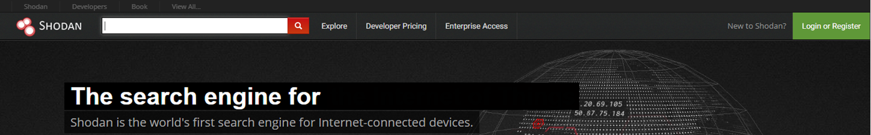
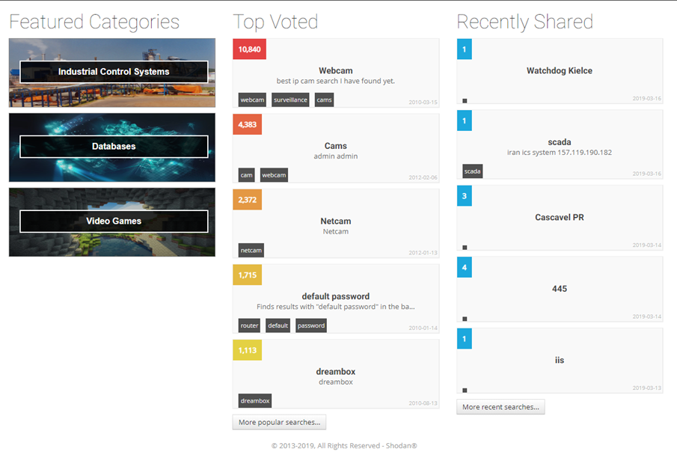
“Exploring the world around you”

Slide 4

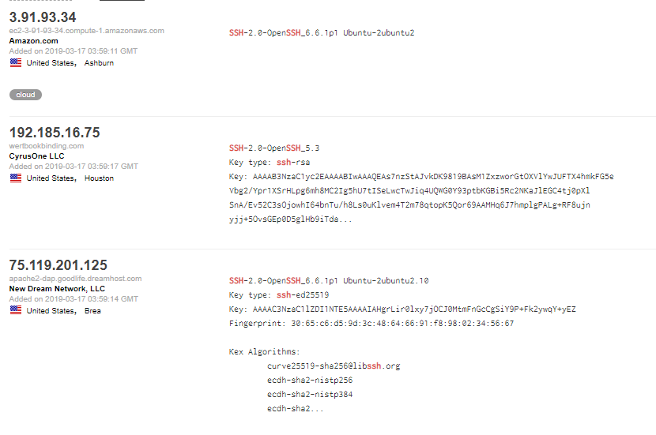
IP Address
Services (ftp, ssh, apache)
Manufacturer/model #’s
Filters/Facets (available with an account)
Notes:
Don’t forget browser plug in

Slide 5



Slide 6

What is Maltego?
Maltego is proprietary software used for open-source intelligence and forensics, developed by Paterva. (Courtesy of Wikipedia)

Slide 7
OSINT Tool
Open-source intelligence (OSINT) is data collected from publicly available sources to be used in an intelligence context. In the intelligence community, the term “open” refers to overt, publicly available sources (as opposed to covert or clandestine sources). (Courtesy of Wikipedia)

Slide 8
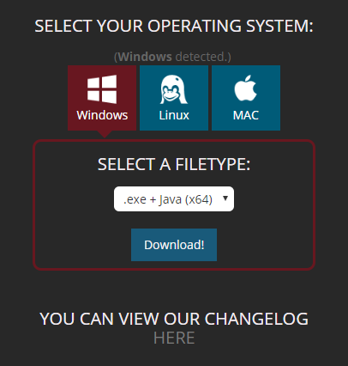
www.paterva.com (Maltego CE – Community Edition)
Cross platform (Windows, Linux, Mac)
Pre-installed in Kali Linux
Notes:
Kali version will need to be updated

Slide 9
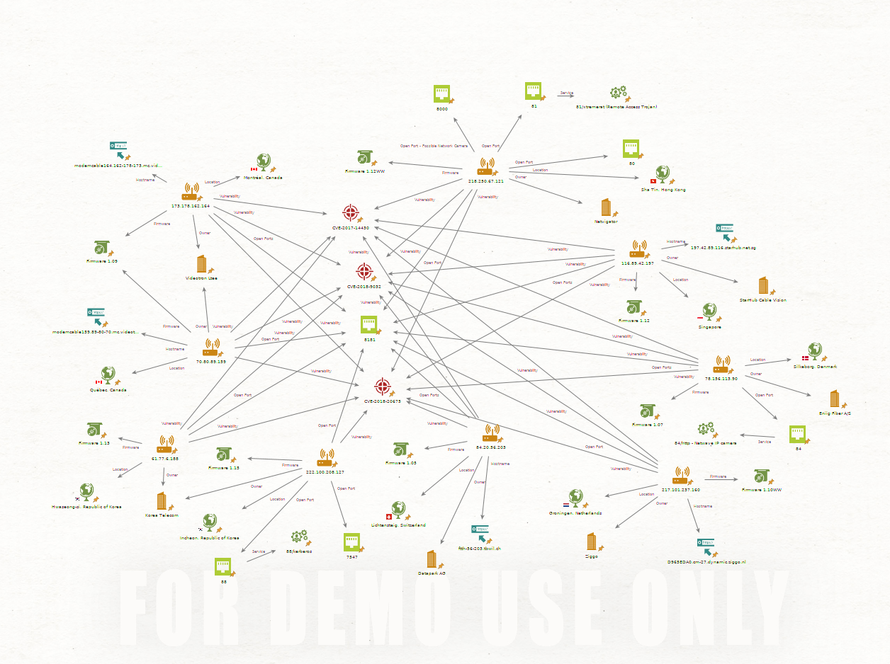

Slide 10
Building options
Manual Input
Pre-built Entities
Custom built Entities
Automated Input
Pre-built Transforms
Custom built Transforms

